Slide 1
App Service Logic Apps

Slide 2
Agenda
Azure App Service
Logic Apps
Vision
Authoring Logic Apps
Architecture

Slide 3
Azure App Service

Slide 4


Apps using Microsoft Azure
Hyper-scale
Agility
Insight

Slide 5


Azure App Service Build and scale great cloud apps
Web Apps
Mobile Apps
Logic Apps
API Apps

Slide 6



Web Apps
Logic Apps
Mobile Apps
Administration App
Customer site
Order Completed
Customer App
http
SQL
API Apps

Slide 7
Logic Apps

Slide 8
SaaS integration

Slide 9
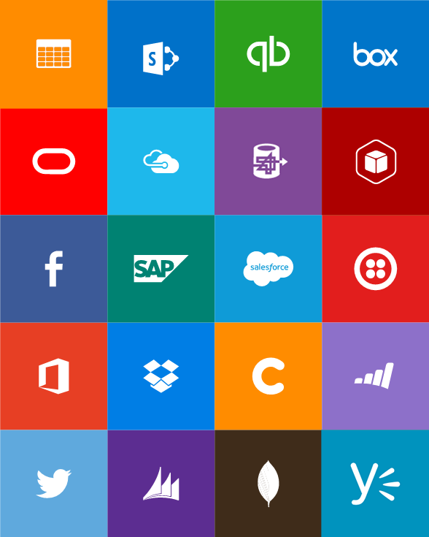
Built-in API Connectors
Connectors
Box
Chatter
Delay
Dropbox
Azure HD Insight
Marketo
Azure Media Services
OneDrive
SharePoint
SQL Server
Office 365
Oracle
QuickBooks
SalesForce
Sugar CRM
SAP
Azure Service Bus
Azure Storage
Timer / Recurrence
Twilio
Twitter
IBM DB2
Informix
Websphere MQ
Azure Web Jobs
Yammer
Dynamics CRM
Dynamics AX
Hybrid Connectivity
Protocols
BizTalk Services
HTTP, HTTPS
File
Flat File
FTP, SFTP
POP3/IMAP
SMTP
SOAP + WCF
Batching / Debatching
Validate
Extract (XPath)
Transform (+Mapper)
Convert (XML-JSON)
Convert (XML-FF)
X12
EDIFACT
AS2
TPMOM
Rules Engine

Slide 10
Target audience is anyone who can use Azure
… but not necessarily business users or consumers

Slide 11
New Logic Apps for easy automation
No code designer for rapid creation
Dozens of pre-built templates to get started
Out of box support for popular SaaS and on-premises apps
Use with custom API apps of your own
Biztalk APIs for expert integration scenarios
LOGIC Apps
Automate SaaS and
on-premises systems

Slide 12
All of the Azure-native capabilities you’d expect
Full audit logs of all management operations
Role-based access control
Deployment lifecycle with Resource Manager
Resource Management API + resource PowerShell
On-prem support with release of Azure Stack

Slide 13
Vision

Slide 14
Vision
Democratize
Integration
iPaaS
Leader
Rich
Ecosystem

Slide 15
Authoring Logic Apps

Slide 16
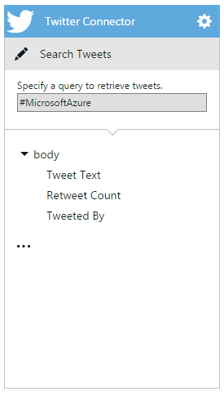
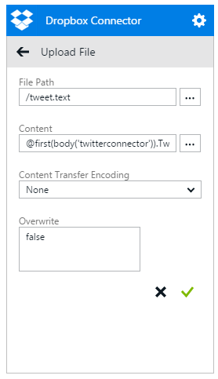

Slide 17
Logic apps for orchestration across API apps
Implicitly – whenever you reference the output of an action you’ll depend on that action executing first
Explicit “dependsOn” condition – you can mark certain actions to run only after previous ones have completed
Explicit “expression” condition – a complex function that evaluates properties of other actions

Slide 18
Repeating
Loop a single action over a list of items
Runs the action N times
You can get at all of the statuses for each action
Tip: when you have multiple collections use:
"repeat" : "@range(0,length(body('connector1')))"
…
"inputs" : "@concat(body('connector1')[repeatItem()], body('connector2')[repeatItem()])"

Slide 19
Conditionals
Logic on a trigger or action
For triggers conditionals are post-conditions
For actions conditionals are pre-conditions
You can do conditionals inside of repeats to perform as a filter

Slide 20
Architecture
The Azure Resource manager is a highly-scalable geo-distributed system that handles millions of resources across 100,000’s of subscriptions. Can create 200 node cluster in < 5 minutes!

Slide 21
Same underlying engine…
Resource Manager
Logic Apps
Can handle thousands of parallel deployments per stamp
Resilient against failure – retries with “at least once” guarantee
Simple, declarative JSON template
Automatically infers dependences between resources
Can handle thousands of parallel runs per stamp
Resilient against failure – retries with “at least once” guarantee
Simple, declarative JSON definition
Automatically infers dependences between actions

Slide 22
… more power
Resource Manager
Logic Apps
8 functions for basic referencing and string functions
Can only PUT resources into resource groups
Auth must be through AAD
Triggered manual through UI or API
Over 50 functions from string manipulations to math, to sets operations, to logical operators
All HTTP operations supported on any arbitrary endpoint
Supports many OAuth providers, AAD, Cert auth, or Basic auth
Different ways to be triggered including recurrence

Slide 23
Try App Service: Logic Apps today
https://tryappservice.azure.com
Ask Questions:
Twitter:
Email
Public forum:

Slide 24
Q&A

Slide 25


Get started
Visit azure.microsoft.com

